Slide 1
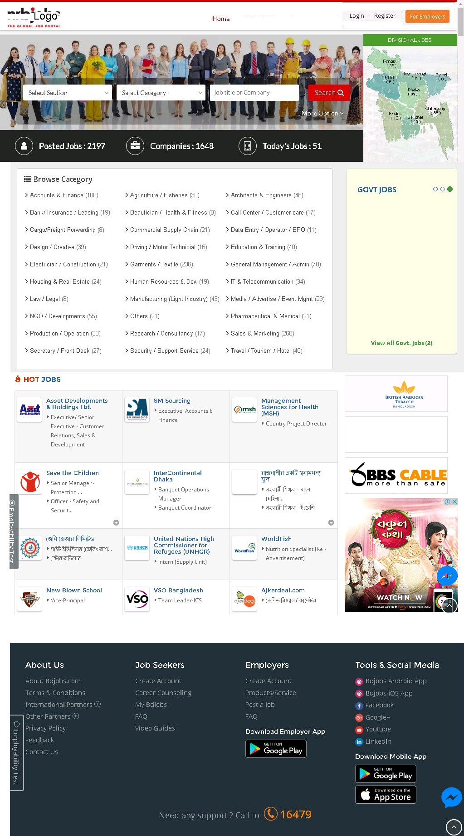
www.bdjobs.com.bd
Bikroy.com

